Slide 1

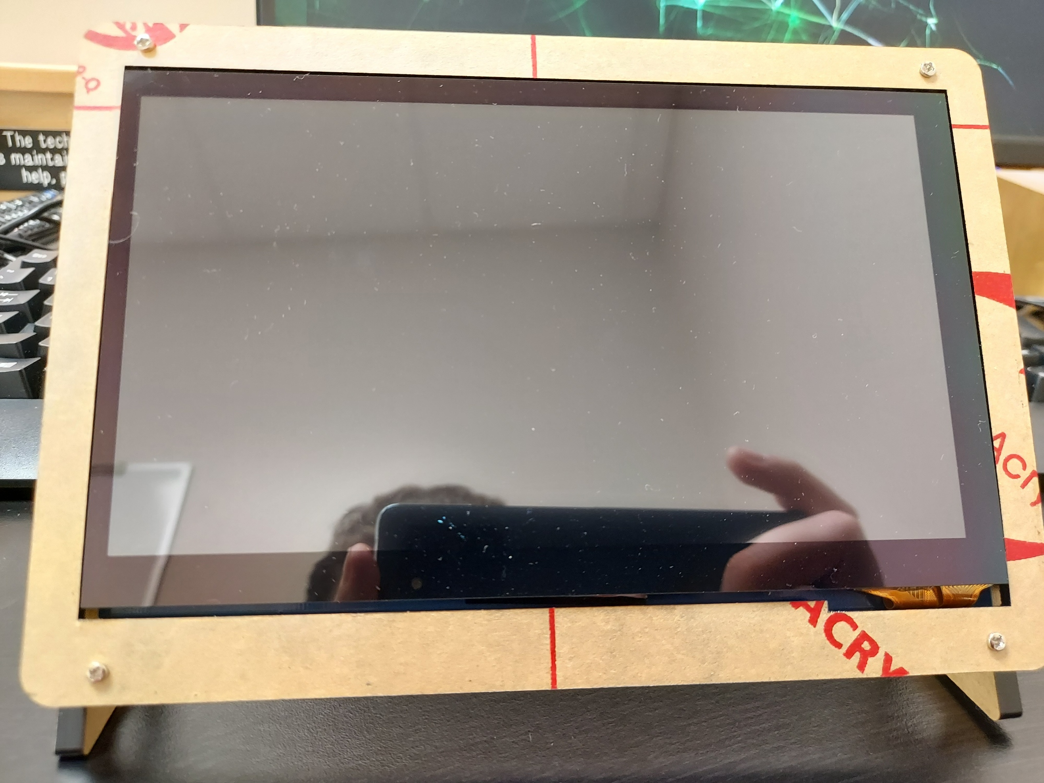
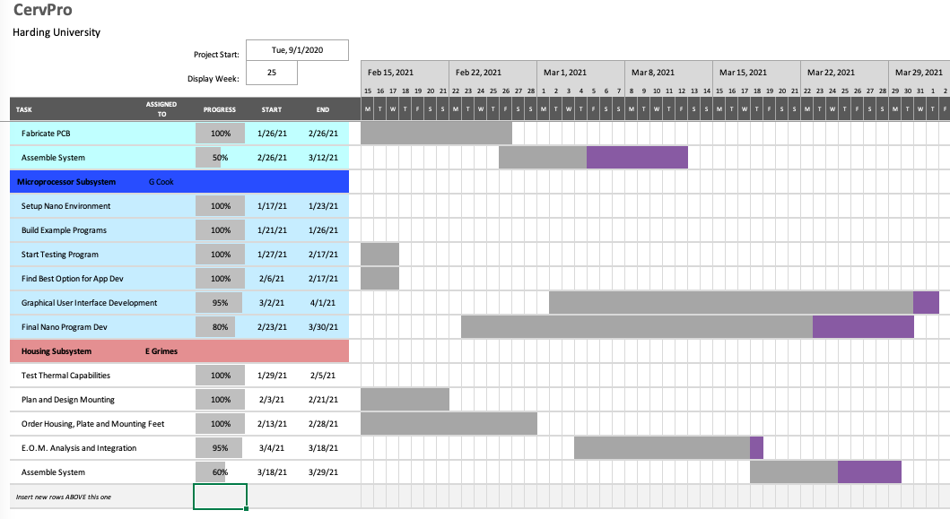

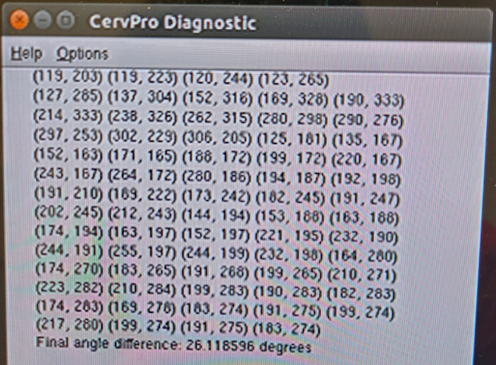
CervPro
Cervical Proprioception Diagnosis: A3 Status
Date: April 15, 2021
Members: Nathan Vielmette, Ethan Grimes, Keneth Chelelgo, and George Cook
Background
PT cervical proprioception (CP) assessments are subjective and determined by PT opinion
Motivation is to create device that gives PTs objective data that shows patients’ ability to sense head and neck position in space
Device will sense head position and angular velocity
Proposed Countermeasures
Double-check Linux/Ubuntu file structure
Check existing windows and compare how they differ
Verify values through testing
3. Integrate scaling factor proportional to error seen through testing
Current Conditions
2nd PCB almost complete
Angular position is
mostly done
Recent Results
Program can now calculate final head position relative to starting position
Program now stores point coordinates in log
Log can be toggled on and off
Touch screen has been assembled and tested
All PCB parts have been sourced and tested
Soldered most difficult PCB components
Final assembly of device has begun
Testing appointments with PT students set up for this Friday
Goals/Targets
Use of device will be faster than double standard CPE test time ~10 min
Patient will not need to touch any part of device
Accurately measures head position and speed within 5% error margin
Device will be move and <10lbs
Next Steps
Finish PCB and test (Nathan)
Assemble final version of device (Ethan)
Implement functionality for measuring head velocity (Ethan and George)
Finish GUI and anticipate potential bugs in program (George)
Conduct and lead final testing for the device (Keneth)
Analysis
Log file is not being saved to the desktop
Options window is not being created
Angular position values seem a little high

Slide 2
CervPro
Cervical Proprioception Diagnosis: A3 Status
Date: April 15, 2021
Members: Nathan Vielmette, Ethan Grimes, Keneth Chelelgo, and George Cook

Slide 3
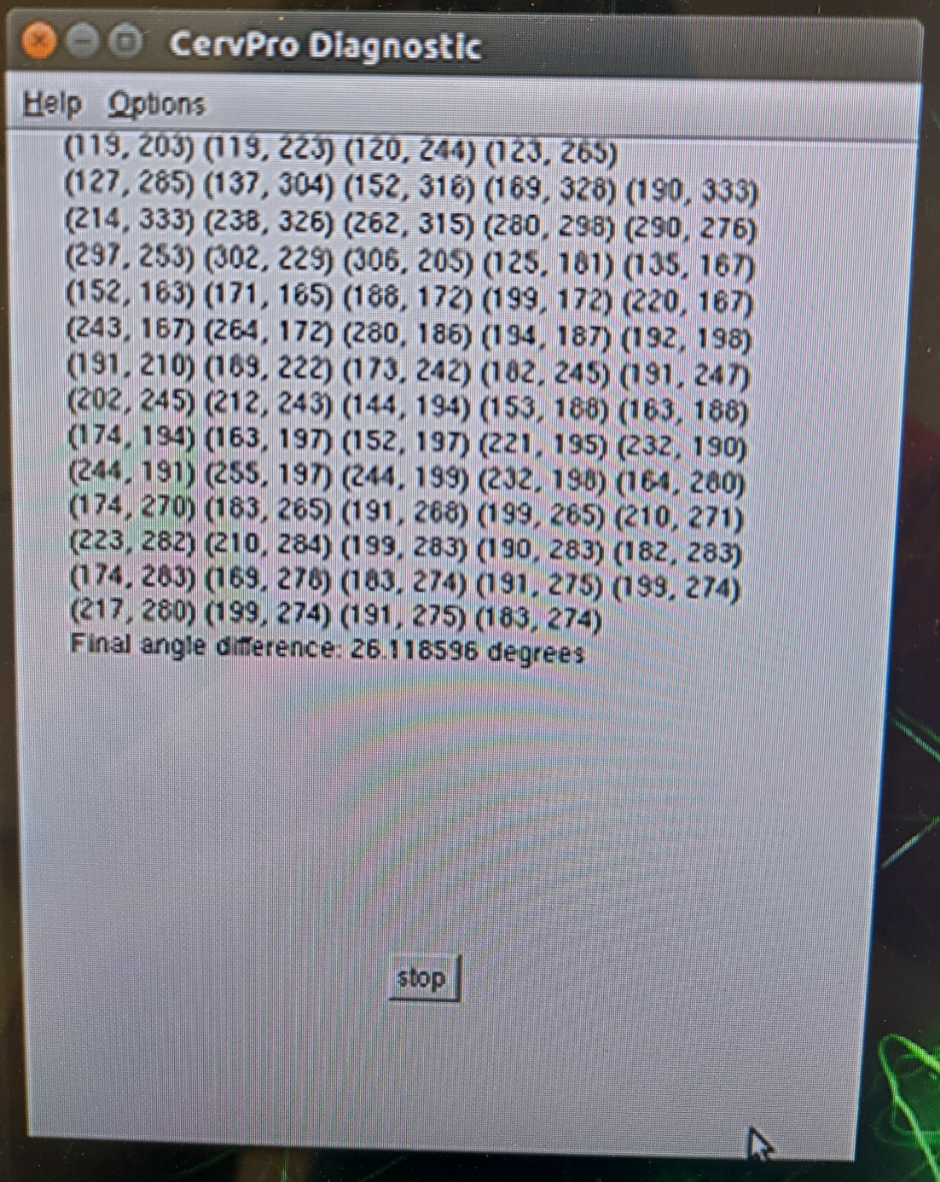
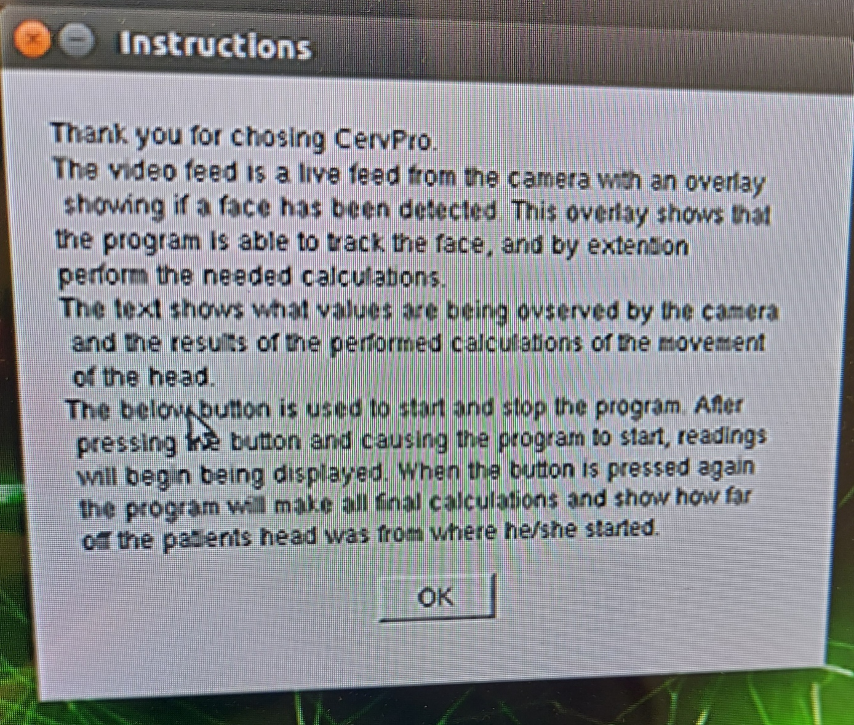
CervPro
Cervical Proprioception Diagnosis: A3 Status
Date: April 15, 2021
Members: Nathan Vielmette, Ethan Grimes, Keneth Chelelgo, and George Cook

Slide 4

CervPro
Cervical Proprioception Diagnosis: A3 Status
Date: April 15, 2021
Members: Nathan Vielmette, Ethan Grimes, Keneth Chelelgo, and George Cook

